Slide 1
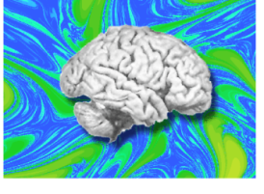
Synchrony and metastable coordination dynamics
in human brain activity
Emmanuelle Tognoli & J. A. Scott Kelso

Slide 2
Attention is an integrative brain function: requires multiple brain areas to coordinate with one another.
We present a theoretical & methodological framework for the analysis of coordination between brain areas.

Slide 3
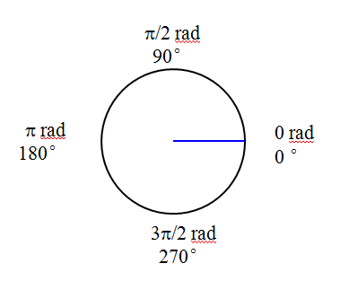
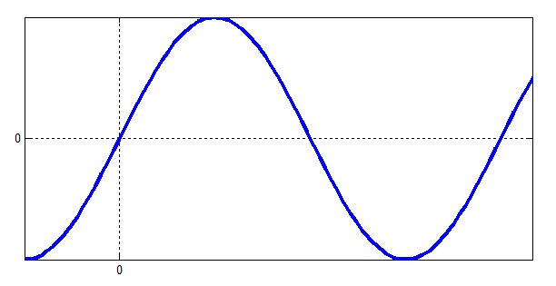
Phase φ of an oscillation
For two oscillations, x_{t} and y_{t}
rp_{t}=φ(x_{t})-φ(y_{t})
If rp_{t}=rp_{t+1}=rp_{t+2…}
Oscillations are phase-locked
time

Slide 4
Coordination dynamics between brain areas
Tognoli & Kelso, in press, Progress in Neurobiology

Slide 5
Predicting true and false synchrony
Coordinated inphase
Coordinated antiphase
2 or more sources
Coordinated out of phase
Metastable
Uncoordinated
Sulcal
1 cortical source
Gyral

Slide 6
E.g. two coupled sources

Slide 7
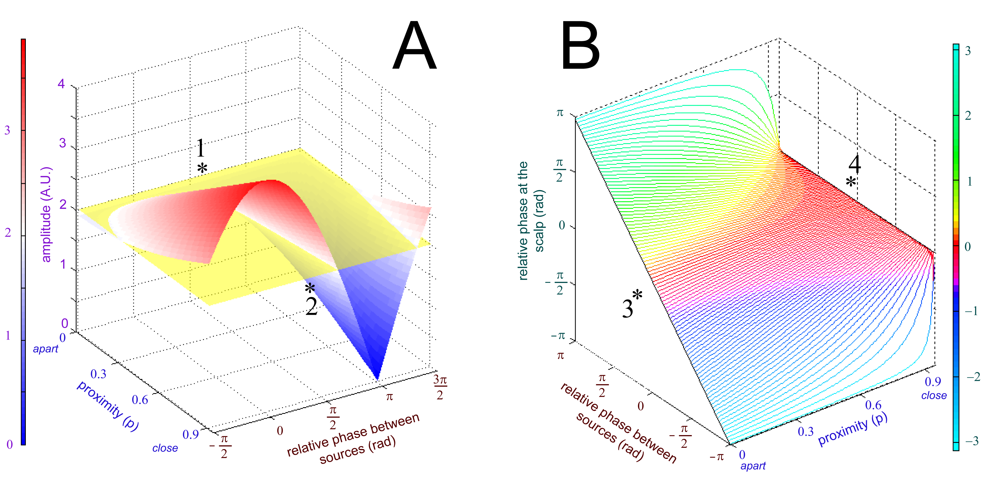
Generalization: amplitude and phase biases
Amplitude of EEG signal does not speak of amplitude of the sources
Inphase (zero-lag) synchrony of EEG signal does not mean inphase between the sources

Slide 8
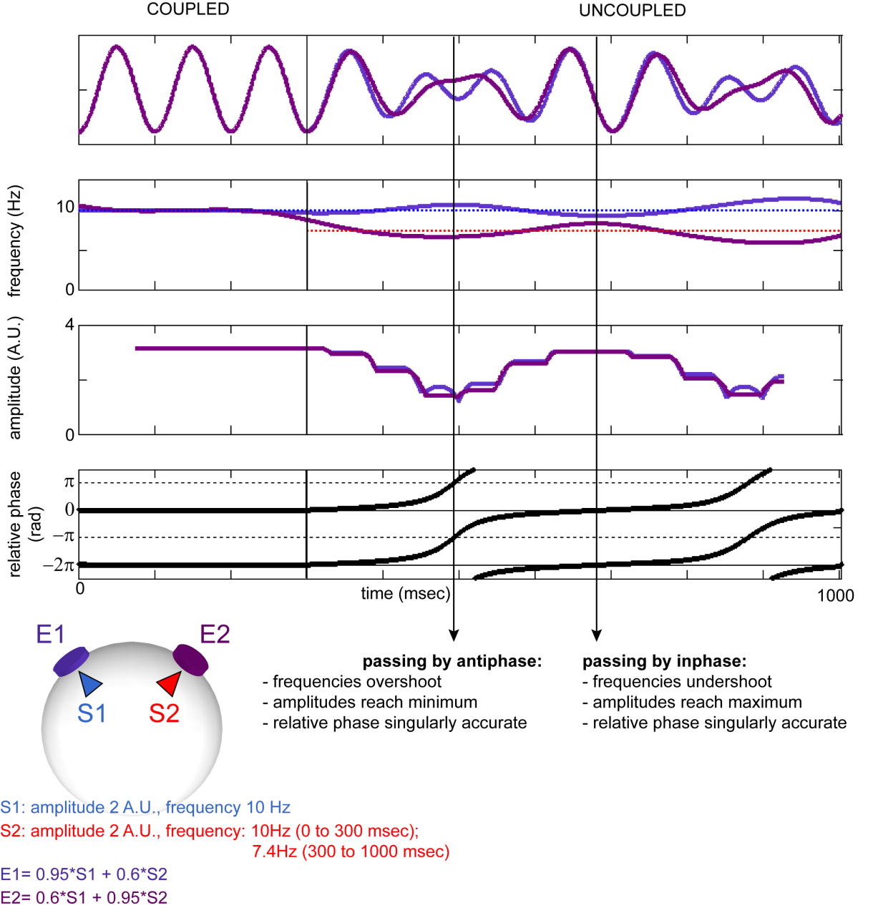
Two uncoupled sources

Slide 9
Apparent inphase locking

Slide 10
Apparent antiphase locking

Slide 11
Spatio-temporal patterns in continuous EEG
False antiphase
False inphase
Real out-of-phase locking

Slide 12
Interim conclusions
Methodological
Theoretical
Real synchrony is rare and brief.
Data suggest that most coordination dynamics in the brain is metastable, (not synchronized states).
Usefulness of time-aggregated coherence studies directly depends on the ratio between real and false synchrony.

Slide 13
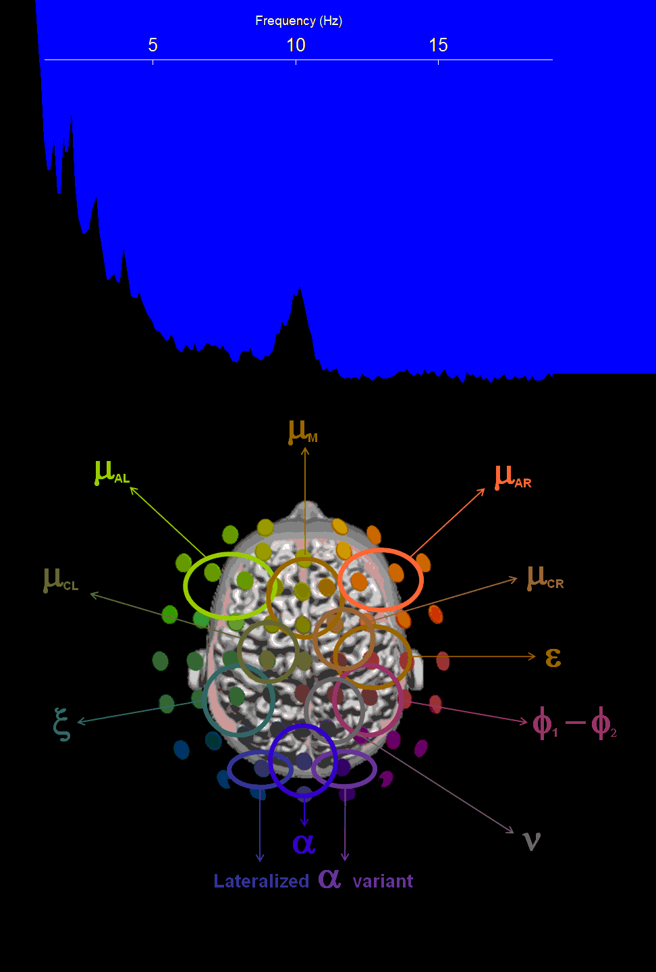
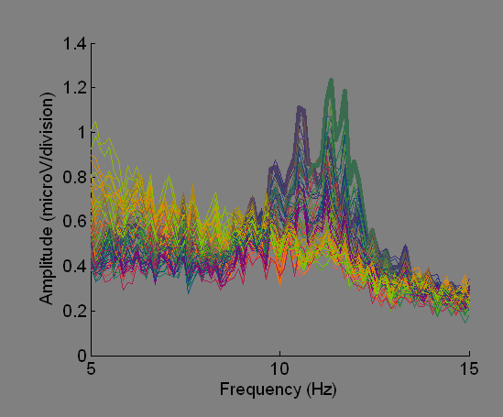
Diversity of 10Hz rhythms in human waking EEG
“α paradox”
α
peak at 11Hz
PO
ERD
ξ
peak at 12Hz
left CP
ERS
Seen during covert spatial attention task
Tognoli & Kelso, in prep

Slide 15
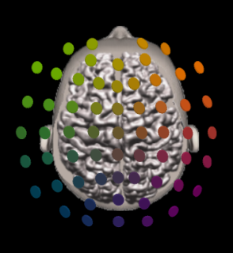
Covert shift
of attention
up
(endogenous)
15 sec
Covert shift
of attention
down
(endogenous)
15 sec
Attention maintained on fixation
5 sec
100 msec
control
19.7%
17%
21.1%
7.2%

Slide 16
Attention:
“Attendere”: to stretch, to tend

Slide 17
Phase-locked BRAIN STATES: specific for Attention?

Slide 18
Support contributed by
Accepting email applications
Postdoctoral Associate
Social Coordination Dynamics
www.ccs.fau.edu/hbbl.html

